Slide 1
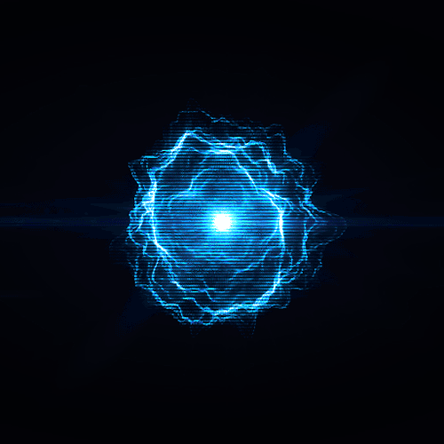
Prompt Fission Neutron Investigation
with Frisch-gridded Twin Back-to-back Ionization Chamber
Dimitar Chereshkov, Technical University – Sofia, Bulgaria
Supervisor – Dr. Shakir Zeinalov, FLNP, JINR

Slide 2
The aim of the project
To get acknowledged with the nuclear electronics, data acquisition and analysis software
Making a neutron-gamma separation, using pulse shape analysis
Performing alpha particle, fission fragment, and prompt fission neutron spectra measurements

Slide 3
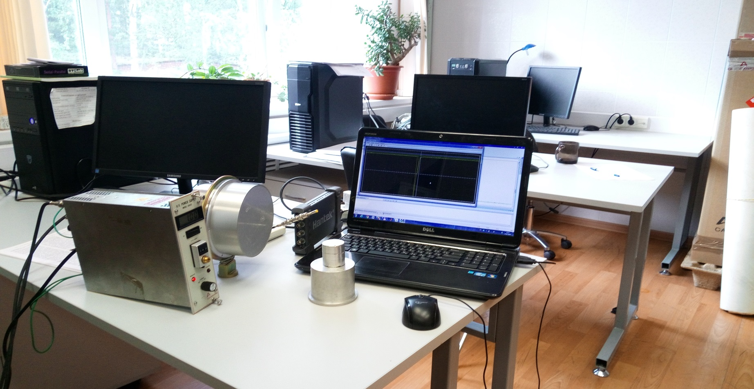
Experimental setup
neutron-gamma separation by pulse shape analysis
Scintillation neutron-gamma detector ( NE 213 )
Analog-to-Digital Converter (ADC)
High voltage power supply
Am-Be source

Slide 4
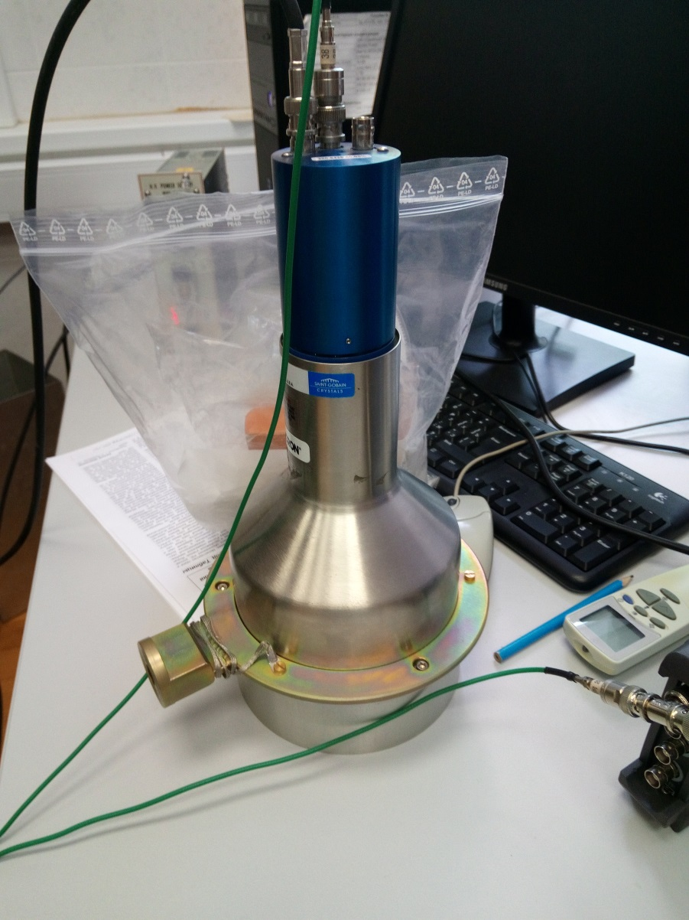
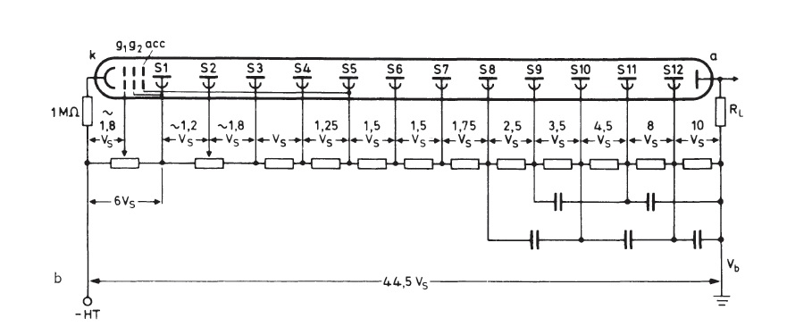
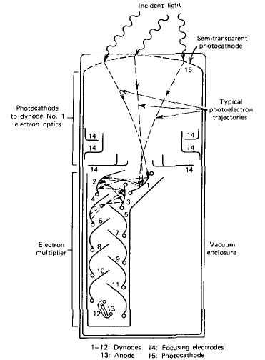
Experimental setup
neutron-gamma separation by pulse shape analysis
Voltage divider
Wiring diagram
Photo-multiplier Tube (PMT)
Scintillation neutron-gamma detector ( NE 213 )

Slide 5
Photomultiplier Tubes (PMT)
Certain materials, struck by a nuclear particle or radiation, emit a small flash of light ( a scintillation ).
PMT convert light signals into a usable current pulse without adding a large amount of random noise to the signal.
The PMT photocathode converts the incident light into a current of electrons by the photoelectric effect.
The electron-multiplier system amplifies the weak primary photocurrent by using a series of dynodes to produce a measurable current at the anode of the photomultiplier.

Slide 6
The experimental results
neutron-gamma separation by pulse shape analysis

Slide 7
The experimental results
neutron-gamma separation by pulse shape analysis

Slide 8
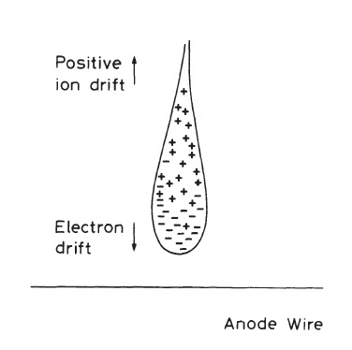
Frisch-gridded ionization chamber
fission fragment spectra measurements
These instruments are based on the direct collection of the ionization electrons produced in a gas by passing radiation.
In the presence of an electric field, the electrons and ions freed by radiation drift along the field lines towards the anode and cathode respectively.

Slide 9
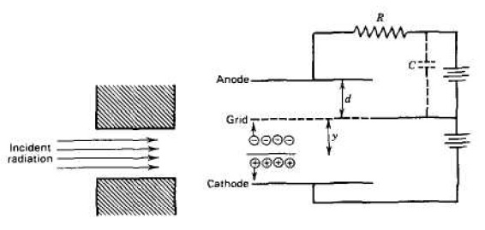
Frisch-gridded ionization chamber
fission fragment spectra measurements
Ion chamber is divided into two parts by a Frisch grid. Once the electrons pass through the grid on their way to the anode, the grid-anode voltage begins to drop and a signal voltage begins to develop across the resistor.
The pulse amplitude is now independent of the position of formation of the original ion pairs.

Slide 10
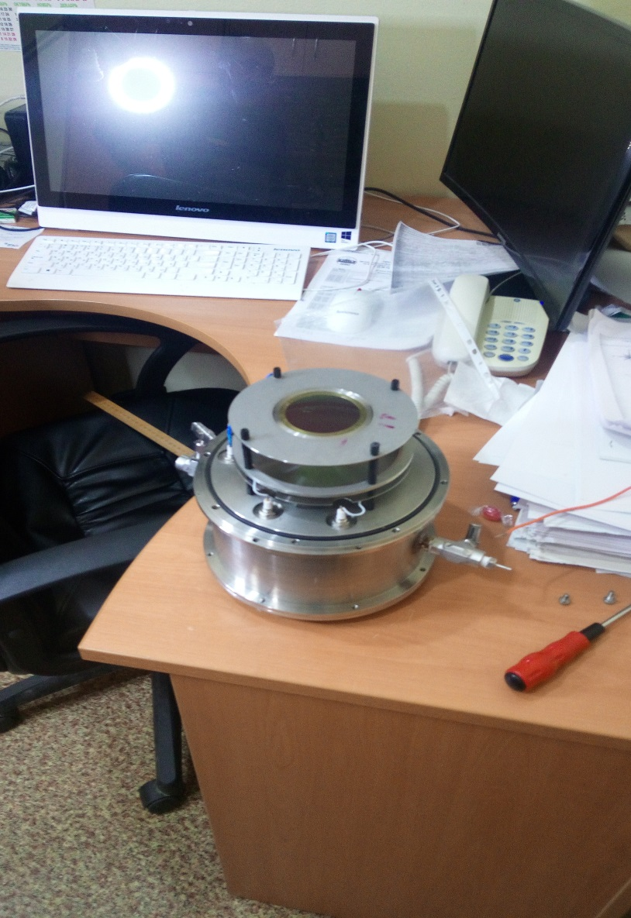
Experimental setup
fission fragment spectra measurements
Cathode with ²⁵²Cf
Frisch grid
Anode

Slide 11
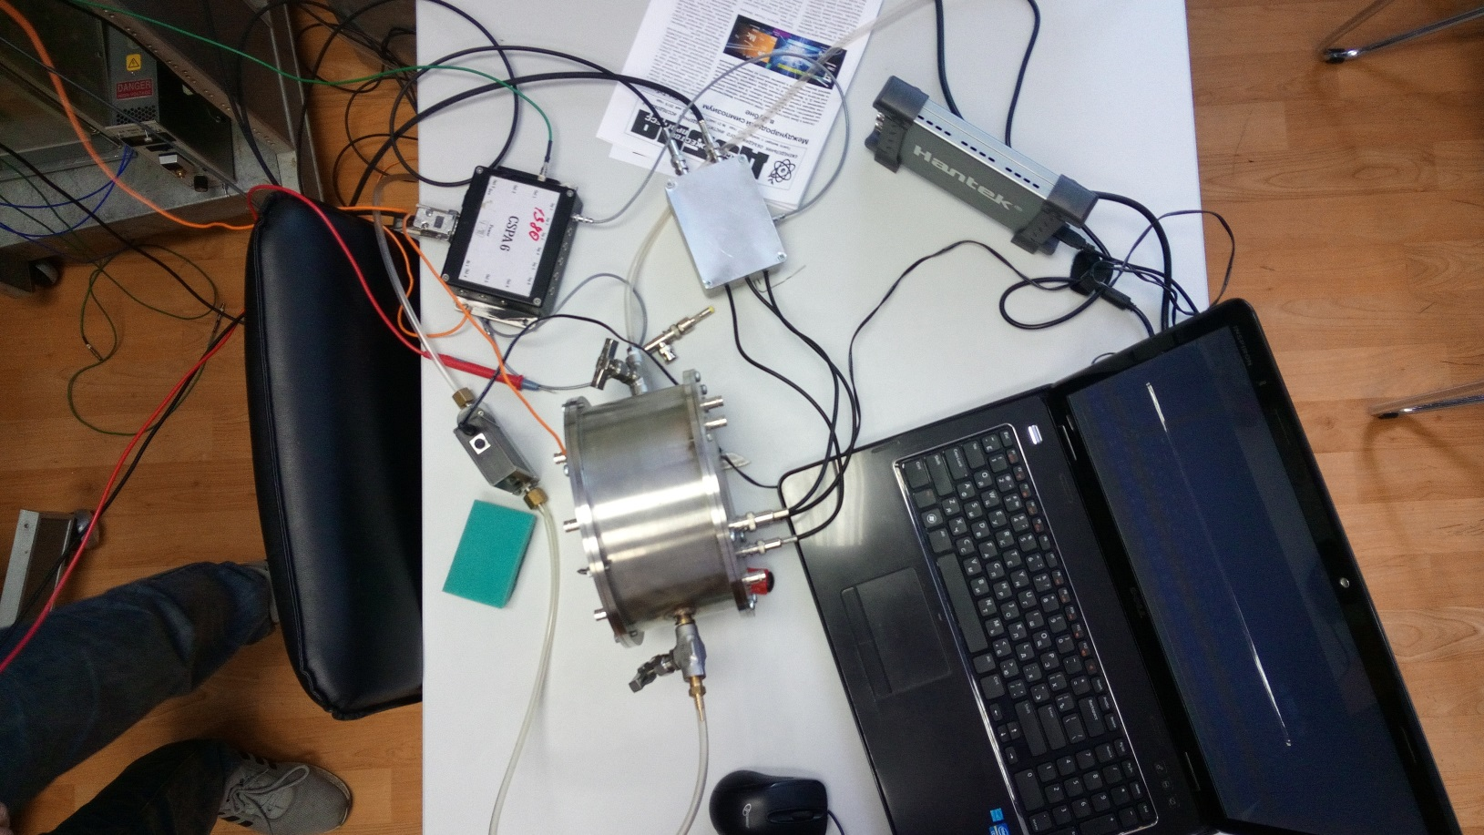
Experimental setup
fission fragment spectra measurements
Preamplifier
High voltage divider
Gas : Ar CH₄
Flow meter
Ion chamber

Slide 12
The experimental results
fission fragment spectra measurements
Anode pulse
Cathode pulse
e

Slide 13
The experimental results
Spontaneous fission fragments spectrum

Slide 14
Conclusions
From the Am-Be source, 4.44 MeV gamma-rays are emitted simultaneously. Intensities of both neutrons and gamma-rays are expected to be very different. The yield of the fission fragments is significantly greater than gamma-rays.
Nuclear fission of ²⁵²Cf is accompanied by fission fragments, emission of α-particles, γ-particles and neutrons ( one gram ²⁵²Cf emits 3*10¹² neutrons/second ).

Slide 15
Bibliography
[1] N. Bohr, J.A. Wheeler, Physical Review 56 (1939) 426.
[2] H. R. Bowman, S. G. Thompson, J. C. D. Milton, W. J. Swiatecki, Physical Review 129 (1963) 2133.
[3] K. Skarsvag, I. Singstad, Nuclear Physics 62 (1962) 103.
[4] C. Budtz-Jørgensen and H.-H. Knitter , Nucl. Phys. A 490 (1988) 307.
[5] “Photomultiplier tubes, principle and applications,” pp. 2–9, Photonis Imaging Sensors, Merignac, France, 2002.
[6] O. Zeynalova, Sh. Zeynalov , F.-J. Hambsch and S. Oberstedt, “DSP Algorithms for Fission Fragment and Prompt Fission Neutron Spectroscopy in Application of Mathematics in Technical and Natural Sciences-2010, edited by M. D. Todorov and C.I. Christov, AIP Conference Proceedings 1301, American Institute of Physics, Melville, NY (2010) 430.
[7] O.V. Zeynalova, Sh.S. Zeynalov, F.-J. Hambsch, S. Oberstedt, Bulletin of Russian Academy of Science: Physics, 73, 506-514 (2009).
[8] F.-J. Hambsch, S. Oberstedt, Nucl. Phys. A617 (1997) 347.
[9] O. Zeynalova, Sh. Zeynalov , F.-J. Hambsch, S. Oberstedt and I. Fabry, “DSP Algorithms for Fission Fragment and Prompt Fission Neutron Spectroscopy in Application of Mathematics in Technical and Natural Sciences-2010, edited by M. D. Todorov and C. I. Christov, AIP Conference Proceedings 1186, American Institute of Physics, Melville, NY (2009) 156.
[10] S. Nakamura, T. Mukai, M. Manabe and I. Murata, Characterization Test of CdTe Detector Element Designed and Developed for BNCT-SPECT, Proc. of the 2011 Annual Symposium on Nucl. Data, JAEA-Conf 2012-001, (2012), pp.165-170.
[11] K. Harada and I. Murata, Design and Construction of A Thermal Column Using An Am-Be Neutron Source for BNCT studies, Proc. of the 2011 Annual Symposium on Nucl. Data, JAEA-Conf 2012-001, (2012), pp.129-134.

Slide 16
Acknowledgements
I would like to express my gratitude to
the International Student Practice organizers.
I thank Dr. Shakir Zeinalov
for his passion and valuable guidance during the whole practice.
I thank Dr. Pavel Sedishev
for his permanent interest to my work.
Special thanks to the colleagues from FLNP
who made my work here meaningful, interesting and pleasurable!

Slide 17
Thank you for the attention!

